Slide 1

Session 6:
Modeling States with UML Statechart Diagrams
Analysis and Specification of Information Systems
Spring 2008
Eran Toch
http://www.technion.ac.il/~erant

Slide 2

How does a Washing Machine Work?
On / Off button. Start button (No stop button.)
Feedback is given on the current stage (soaking, rinsing, draining, drying)
Three plans:
  Regular
  Delicate (no soaking)
  Super delicate (no soaking, no drying)
Off can be clicked only before starting, or after finishing
Intro | Building Blocks | Advanced

Slide 3
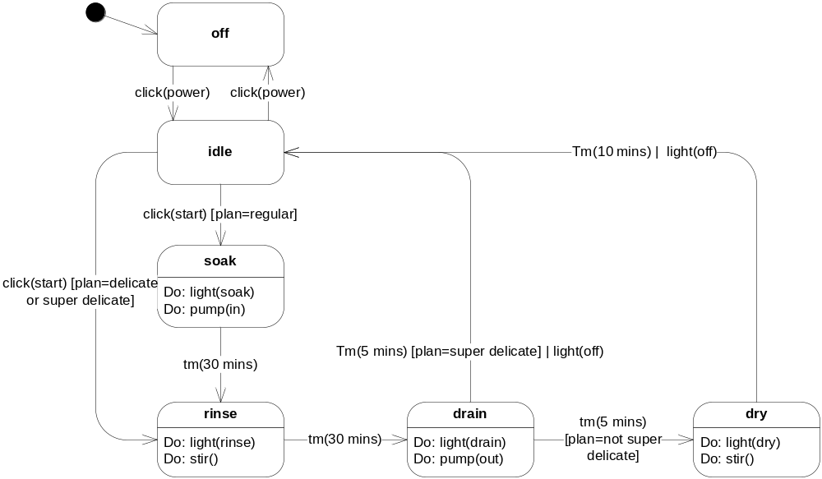
Washing Machine
Intro | Building Blocks | Advanced

Slide 4
State Explosion: An Example
What is the off button can be clicked at any time?
What if we want to come back to the same state we left?
Intro | Building Blocks | Advanced

Slide 5
The State Explosion Problem
Class 1
Class 2
Class n
v₁ : {t, f}
v₂ : {t, f}
v₃ : {t, f}
...
v_{m} : {t, f}
v₁ : {t, f}
v₂ : {t, f}
v₃ : {t, f}
...
v_{m} : {t, f}
v₁ : {t, f}
v₂ : {t, f}
v₃ : {t, f}
...
v_{m} : {t, f}
...
Let
  n: Num of Classes
  m: Num of variables (assume equality among classes)
Number of possible states = 2^{(nm)}
And...
  What if the state space of each variable > 2
Intro | Building Blocks | Advanced
Notes:
This slide should be before the parallel states explanation

Slide 6


Abstraction in Statechart
Finding Common Behavior
Separating Independent Regions
Composite States
Parallel States
Intro | Building Blocks | Advanced

Slide 7
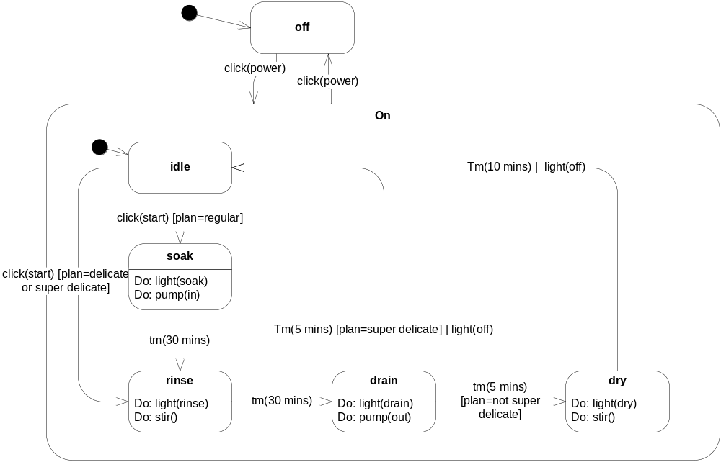
Composite States
Intro | Building Blocks | Advanced
Notes:
Composite states give us a level of abstraction in statechart modeling
Formally, a common characteristics for a group of states is the common transition they share
Composite states can aid in:
Allowing better understanding of a system model
Dramatically reducing the number of transitions
Reducing errors by employing initial states
Rules for composite states:
Each composite state must have an initial state and some final states

Slide 8
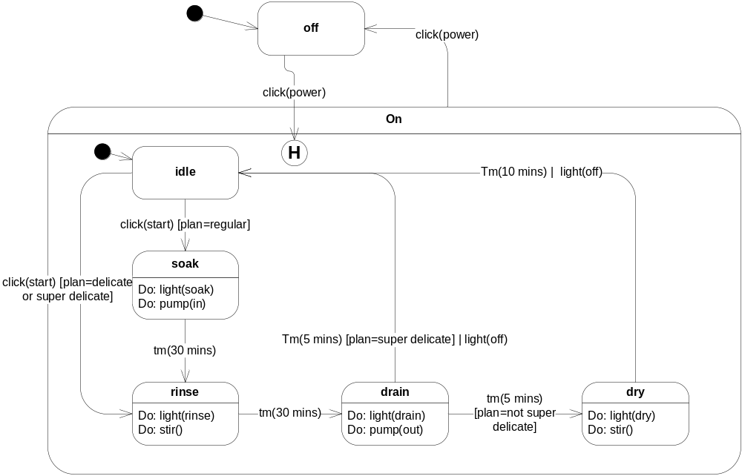
Composite + History

Slide 9
deep and shallow
Shalow = mais superficial (que está mais em cima)
Stop
Shift ended | clh()
pause
Diagnosing
return
H
Diagnostic1
Diagnostic2
return-full
H*
setup
Find a vein
clh() – clears the history
Check blood pressure
Draw Blood
* = deep
Retorna para o estado mais interno
Intro | Building Blocks | Advanced

Slide 10
Completion Transitions
Triggered by a completion event
  generated automatically when an immediately nested state machine terminates
Committing
completion
transition (no trigger)
Phase1
Commit Done
Phase2
Intro | Building Blocks | Advanced

Slide 11
Triggering Rules
Two or more transitions may have the same event trigger
  inner transition takes precedence
  if no transition is triggered, event is discarded
LampFlashing
FlashOn
on/
off/
on/
FlashOff
Intro | Building Blocks | Advanced

Slide 12
Order of Actions: Complex Case
Same approach as for the simple case
S1
exit:exS1
S2
entry:enS2
| initS2
S11
exit:exS11
E/actE
S21
entry:enS21
Actions execution sequence:
exS11⇨ exS1 ⇨ actE⇨enS2 ⇨ initS2 ⇨ enS21
Intro | Building Blocks | Advanced

Slide 13

Parallel States
Sometimes, some aspect of an entity are independent of other aspects
Person
employee
single
Staff
Member
married
Manager
divorced
Intro | Building Blocks | Advanced

Slide 14
Parallel States Annotation
Combine multiple simultaneous descriptions
Martial
employee
single
Staff
Member
married
Martial
employee
single
Manager
divorced
Staff
Member
married
divorced
Manager
Intro | Building Blocks | Advanced

Slide 15
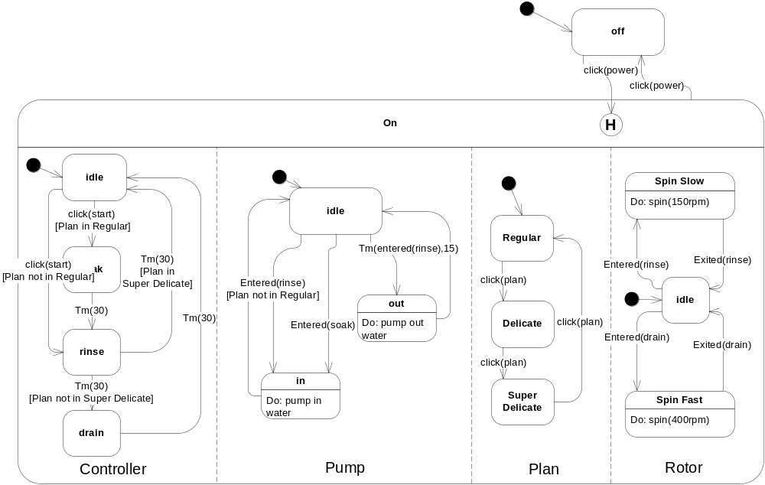
Interactions Between Parallel States
Intro | Building Blocks | Advanced

Slide 16
Transition Forks and Joins
For transitions into/out of orthogonal regions:
shipping
Processing
Sent
Confirmed
Credit Card
verification
[ok]
Receipt Sent
fork
[not ok]
Join
charging
In problem
Intro | Building Blocks | Advanced
Notes:
If we use a join, the composite states ends when all parallel regions had ended. If we use a simple transition (such as the one between “credit card verification” to “In Problem”), then we exit all the parallel states.

